Slide 1

Clicker Questions
Chapter 3
Atoms and Ionic Bonds
Donald Linn
Indiana University–
Purdue University Fort Wayne
Fort Wayne, IN

Slide 2
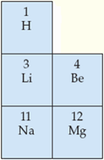
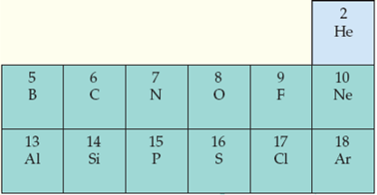
Which of the species listed below has the largest radius?
a) Li⁺
b) O
c) S
d) Cl–
e) F–
Notes:
Answer: d

Slide 3
Which of the species listed below has the largest radius?
a) Li⁺
b) O
c) S
d) Cl–
e) F–
Notes:
Answer: d

Slide 4
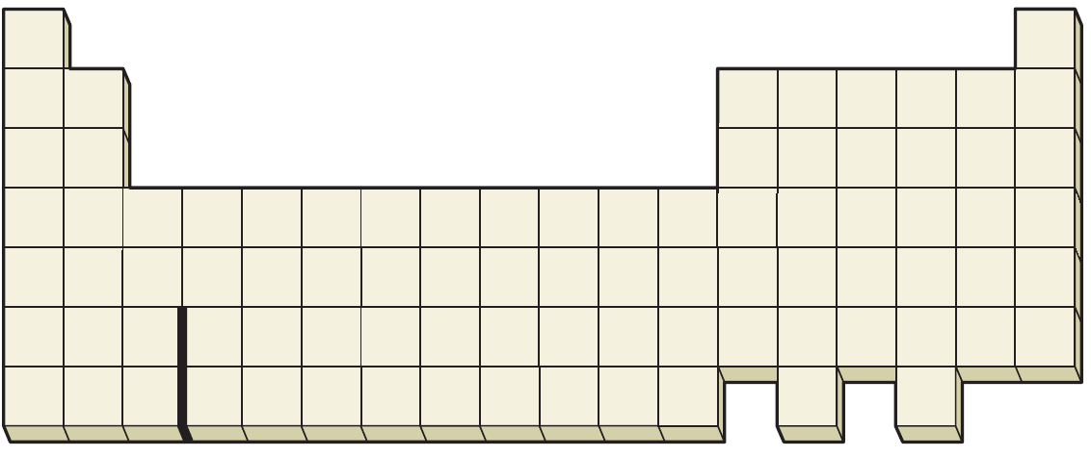
Which of the numbers below refers to the place in the periodic table where the element should have the highest ionization energy?
a
b
c
d
e
Notes:
Answer: b

Slide 5
Which of the numbers below refers to the place in the periodic table where the element should have the highest ionization energy?
a
b
c
d
e
Notes:
Answer: b

Slide 6
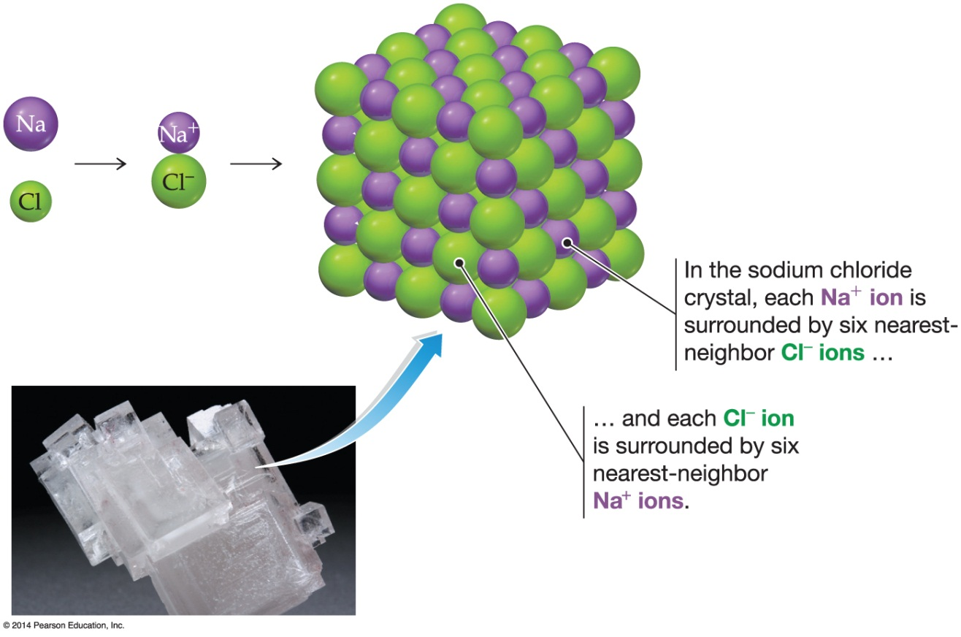
Which of the following would you expect to have the largest lattice energy?
a) KBr
b) NaBr
c) NaCl
d) LiF
e) LiCl
Notes:
Answer: d

Slide 7
Which of the following would you expect to have the largest lattice energy?
a) KBr
b) NaBr
c) NaCl
d) LiF
e) LiCl
Notes:
Answer: d

Slide 8
Which of the following is a correct formula for an ionic compound (i.e., the others would not likely exist as ionic compounds)?
a) MgCl
b) LiO₂
c) Be₂F
d) Na₂S
e) NeF₂
Notes:
Answer: d

Slide 9
Which of the following is a correct formula for an ionic compound (i.e., the others would not likely exist as ionic compounds)?
a) MgCl
b) LiO₂
c) Be₂F
d) Na₂S
e) NeF₂
Notes:
Answer: d

Slide 10
Below are the first seven ionization energies for a third period element. To which element do these ionization energies belong?
IE₁ - 1012
IE₂ - 1903
IE₃ - 2912
IE₄ - 3956
IE₅ - 6273
IE₆ - 22233
IE₇ - 27106
a) B
b) Si
c) N
d) P
e) S
Notes:
Answer: d

Slide 11
Below are the first seven ionization energies for a third period element. To which element do these ionization energies belong?
IE₁ - 1012
IE₂ - 1903
IE₃ - 2912
IE₄ - 3956
IE₅ - 6273
IE₆ - 22233
IE₇ - 27106
a) B
b) Si
c) N
d) P
e) S
Notes:
Answer: d

Slide 12
Which of the following lists has the species increasing in radius?
a) Kr, Ar, Cl–, S^{2–}
d) F–, O^{2–}, N^{3–}, P^{3–}
b) Li⁺, Be²⁺, B³⁺
e) Cl–, S^{2–}, P^{3–}, Al³⁺
c) I–, Br–, Cl–, F–
Notes:
Answer: d

Slide 13
Which of the following lists has the species increasing in radius?
a) Kr, Ar, Cl–, S^{2–}
d) F–, O^{2–}, N^{3–}, P^{3–}
b) Li⁺, Be²⁺, B³⁺
e) Cl–, S^{2–}, P^{3–}, Al³⁺
c) I–, Br–, Cl–, F–
Notes:
Answer: d

Slide 14
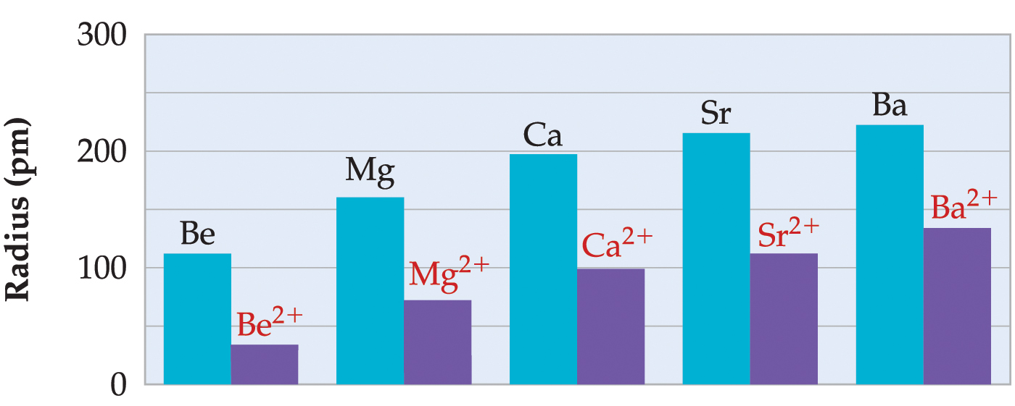
Which of the following electron configurations do you think is for an atom which would form an ion with the largest radius?
a) [Ar] 4s²
b) [Ne] 3s²3p³
c) [He] 2s²2p⁴
d) [Ne] 3s²3p⁴
e) [Ne] 3s²3p⁵
Notes:
Answer: b

Slide 15
Which of the following electron configurations do you think is for an atom which would form an ion with the largest radius?
a) [Ar] 4s²
b) [Ne] 3s²3p³
c) [He] 2s²2p⁴
d) [Ne] 3s²3p⁴
e) [Ne] 3s²3p⁵
Notes:
Answer: b

Slide 16
Which doubly charged cation has the following ground-state electron configuration?
1s² 2s² 2p⁶ 3s² 3p⁶ 3d¹⁰
a)
b)
c)
d)
e)
Notes:
Answer: d

Slide 17
Which doubly charged cation has the following ground-state electron configuration?
1s² 2s² 2p⁶ 3s² 3p⁶ 3d¹⁰
a)
b)
c)
d)
e)
Notes:
Answer: d

Slide 18
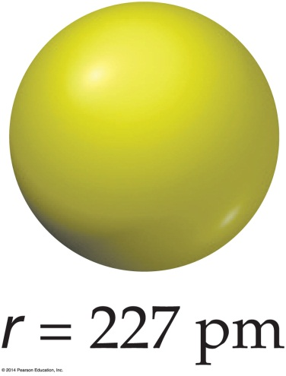
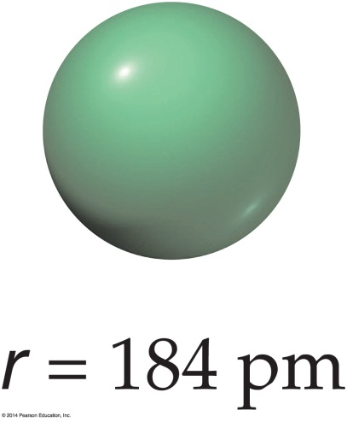
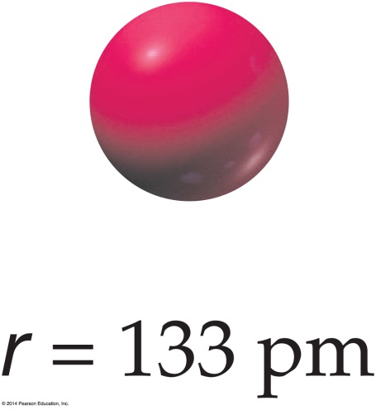
Below are representations of K, K⁺, and Cl–. Which one would be K⁺?
a)
b)
c)
d) impossible to determine
e) none of the above
Notes:
Answer: c

Slide 19
Below are representations of K, K⁺, and Cl–. Which one would be K⁺?
a)
b)
c)
d) impossible to determine
e) none of the above
Notes:
Answer: c

Slide 20
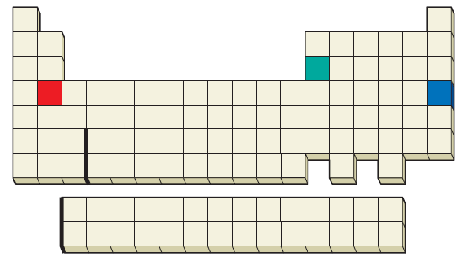
From which of the three elements indicated below is it the easiest to remove the first electron?
b
a
c
d) impossible to determine
e) not possible to remove an electron
Notes:
Answer: a

Slide 21
From which of the three elements indicated below is it the easiest to remove the first electron?
b
a
c
d) impossible to determine
e) not possible to remove an electron
Notes:
Answer: a

Slide 22
From which of the three elements indicated below is it the easiest to remove the third electron?
b
a
c
d) impossible to determine
e) not possible to remove an electron
Notes:
Answer: b

Slide 23
From which of the three elements indicated below is it the easiest to remove the third electron?
b
a
c
d) impossible to determine
e) not possible to remove an electron
Notes:
Answer: b

Slide 24
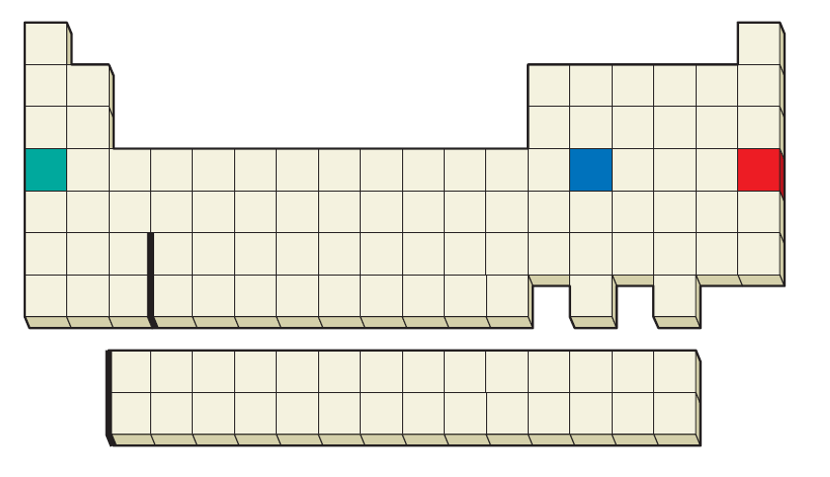
Of the elements listed below, which has a more favorable electron affinity?
a
b
c
d) impossible to determine
e) not possible to remove an electron
Notes:
Answer: c

Slide 25
Of the elements listed below, which has a more favorable electron affinity?
a
b
c
d) impossible to determine
e) not possible to remove an electron
Notes:
Answer: c

Slide 26
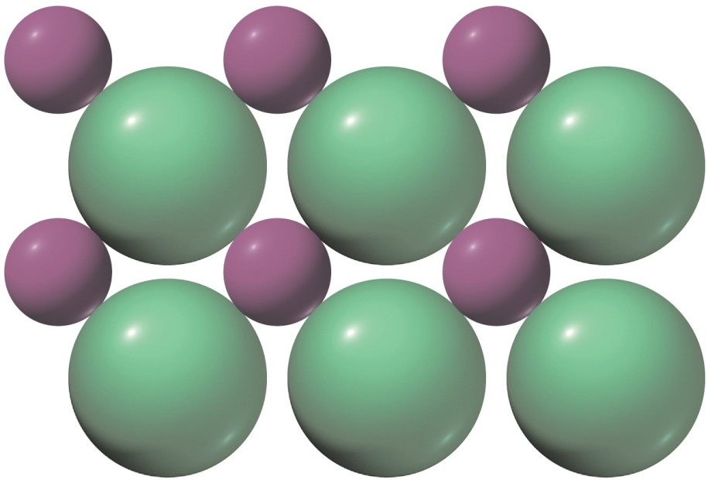
Which of the following ionic solids would you expect to have a larger lattice energy?
a) KCl
d) MgCl₂
b) NaCl
e) MgF₂
c) CaCl₂
Notes:
Answer: e

Slide 27
Which of the following ionic solids would you expect to have a larger lattice energy?
a) KCl
d) MgCl₂
b) NaCl
e) MgF₂
c) CaCl₂
Notes:
Answer: e

Slide 28
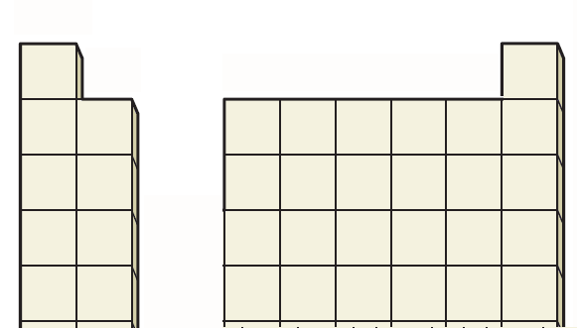
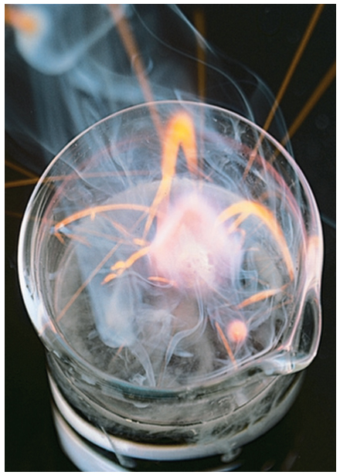
Of the main group metals indicated below, which one is the strongest reducing agent?
a)
b)
c)
d)
e)
Notes:
Answer: c

Slide 29
Of the main group metals indicated below, which one is the strongest reducing agent?
a)
b)
c)
d)
e)
Notes:
Answer: c

Slide 30
Of the non-metals indicated below, which one is the strongest oxidizing agent?
a)
b)
c)
d)
e)
Notes:
Answer: b

Slide 31
Of the non-metals indicated below, which one is the strongest oxidizing agent?
a)
b)
c)
d)
e)
Notes:
Answer: b

Slide 32
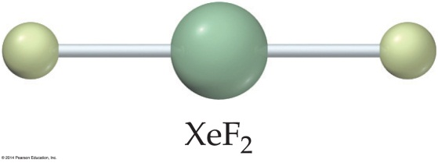
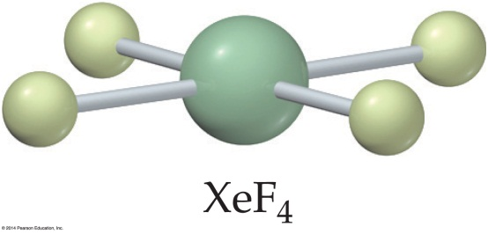
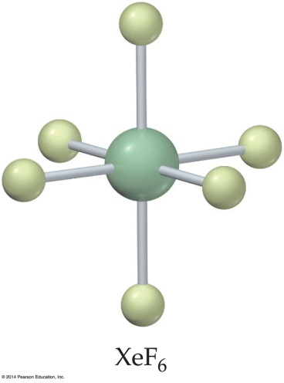
Determine the oxidation number for Xe in XeF₆.
a) 0
d) 6
b) 2
e) 8
c) 4
Notes:
Answer: d

Slide 33
Determine the oxidation number for Xe in XeF₆.
a) 0
d) 6
b) 2
e) 8
c) 4
Notes:
Answer: d

Slide 34
Given the electron affinity for Cl is -348.6 kJ mol^{–1}, the heat of sublimation for lithium is 159.4 kJ mol^{–1}, the ionization energy for lithium is 520 kJ mol^{–1}, the bond dissociation energy for Cl₂ is 243 kJ mol^{–1}, and the heat of formation for LiCl(s) is –408.6 kJ mol^{–1}, what determines the lattice energy for LiCl?
a) 285.2 kJ mol^{–1}
d) 860.9 kJ mol^{–1}
b) 512.3 kJ mol^{–1}
e) 982.4 kJ mol^{–1}
c) 542.1 kJ mol^{–1}
Notes:
Answer: d

Slide 35
Given the electron affinity for Cl is -348.6 kJ mol^{–1}, the heat of sublimation for lithium is 159.4 kJ mol^{–1}, the ionization energy for lithium is 520 kJ mol^{–1}, the bond dissociation energy for Cl₂ is 243 kJ mol^{–1}, and the heat of formation for LiCl(s) is –408.6 kJ mol^{–1}, what determines the lattice energy for LiCl?
a) 285.2 kJ mol^{–1}
d) 860.9 kJ mol^{–1}
b) 512.3 kJ mol^{–1}
e) 982.4 kJ mol^{–1}
c) 542.1 kJ mol^{–1}
Notes:
Answer: d

Slide 36
What electrons are most likely to determine the properties of elements?
a) the inner shell electrons
b) the outer shell electrons
c) the s and p electrons
d) the d and f electrons
e) none of these
Notes:
Answer: b

Slide 37
What electrons are most likely to determine the properties of elements?
a) the inner shell electrons
b) the outer shell electrons
c) the s and p electrons
d) the d and f electrons
e) none of these
Notes:
Answer: b

Slide 38
Which element is a d-transition metal?
a) Ba
b) Nb
c) Mn
d) Sb
e) none of these
Notes:
Answer: c

Slide 39
Which element is a d-transition metal?
a) Ba
b) Nb
c) Mn
d) Sb
e) none of these
Notes:
Answer: c

Slide 40
Which element has the largest atomic radius?
a) Mg
b) Ca
c) Ba
d) Sr
e) none of these
Notes:
Answer: c

Slide 41
Which element has the largest atomic radius?
a) Mg
b) Ca
c) Ba
d) Sr
e) none of these
Notes:
Answer: c

Slide 42
Which element has the smallest atomic radius?
a) Br
b) Cl
c) F
d) O
e) I
Notes:
Answer: c

Slide 43
Which element has the smallest atomic radius?
a) Br
b) Cl
c) F
d) O
e) I
Notes:
Answer: c

Slide 44
Progressing across the period table, the atomic radii decrease in size due to
a) more penetrating s electrons added
b) more penetrating p electrons added
c) more effective nuclear charge
d) less electron repulsion
e) none of the above
Notes:
Answer: c

Slide 45
Progressing across the period table, the atomic radii decrease in size due to
a) more penetrating s electrons added
b) more penetrating p electrons added
c) more effective nuclear charge
d) less electron repulsion
e) none of the above
Notes:
Answer: c

Slide 46
Which one of the following is an ionic?
a) H₂S
b) NH₃
c) HI
d) CaH₂
e) none of the above
Notes:
Answer: d

Slide 47
Which one of the following is an ionic?
a) H₂S
b) NH₃
c) HI
d) CaH₂
e) none of the above
Notes:
Answer: d

Slide 48
Which lists the following elements in order of decreasing electronegativities (F, Mg, Si, N, O, Ca)?
a) F > O > N > Si > Mg > Ca
b) N > Cl > O > Si > Mg > Ca
c) Ca > Mg > Si > F > N > O
d) F > O > N > Mg > Si > Ca
e) none of the above
Notes:
Answer: a

Slide 49
Which lists the following elements in order of decreasing electronegativities (F, Mg, Si, N, O, Ca)?
a) F > O > N > Si > Mg > Ca
b) N > Cl > O > Si > Mg > Ca
c) Ca > Mg > Si > F > N > O
d) F > O > N > Mg > Si > Ca
e) none of the above
Notes:
Answer: a

Slide 50
The octet rule is applies in the all the following except:
a) transition metals
b) the electron configuration preferred by the simple monoatomic anions and cations
c) the electron configuration preferred by the atoms obtained by forming covalent bonds in the main group elements
d) the noble gas valence shell configuration
e) a and b
Notes:
Answer: e

Slide 51
The octet rule is applies in the all the following except:
a) transition metals
b) the electron configuration preferred by the simple monoatomic anions and cations
c) the electron configuration preferred by the atoms obtained by forming covalent bonds in the main group elements
d) the noble gas valence shell configuration
e) a and b
Notes:
Answer: e

Slide 52
What is the formula for calcium phosphate?
a) CaPO₄
b) Ca₂(PO₄)₃
c) Ca₃(PO₄)₂
d) Ca₃(PO₄)₃
e) none of the above
Notes:
Answer: c

Slide 53
What is the formula for calcium phosphate?
a) CaPO₄
b) Ca₂(PO₄)₃
c) Ca₃(PO₄)₂
d) Ca₃(PO₄)₃
e) none of the above
Notes:
Answer: c

Slide 54
Which of the following is true about electrons in
an atom?
a) Removing an electron is endothermic and adding
an electron is exothermic.
b) Both removing an electron and adding an electron is exothermic.
c) Both removing an electron and adding an electron is endothermic.
d) Removing an electron is exothermic and adding an electron is endothermic.
e) none of the above
Notes:
Answer: a

Slide 55
Which of the following is true about electrons in
an atom?
a) Removing an electron is endothermic and adding an electron is exothermic.
b) Both removing an electron and adding an electron is exothermic.
c) Both removing an electron and adding an electron is endothermic.
d) Removing an electron is exothermic and adding an electron is endothermic.
e) none of the above
Notes:
Answer: a

Slide 56
Which is a measure of the strength of ionic bonding?
a) ionization energy of the metal
b) electron affinity of the nonmetal
c) sublimation energy of the metal
d) heat of vaporization of the nonmetal
e) lattice energy
Notes:
Answer: e

Slide 57
Which is a measure of the strength of ionic bonding?
a) ionization energy of the metal
b) electron affinity of the nonmetal
c) sublimation energy of the metal
d) heat of vaporization of the nonmetal
e) lattice energy
Notes:
Answer: e

